Slide 1



Bank Management System
Introducing the Bank Management System, a comprehensive Java-based solution that streamlines the core operations of a financial institution. This project encompasses a diverse range of functionalities, including login, balance inquiry, account creation, registration, withdrawal, and deposit, catering to the evolving needs of modern banking. Designed with efficiency, security, and user-friendliness in mind, this system serves as a powerful tool for banking professionals and customers alike, revolutionizing the way financial services are managed and accessed.

Slide 2

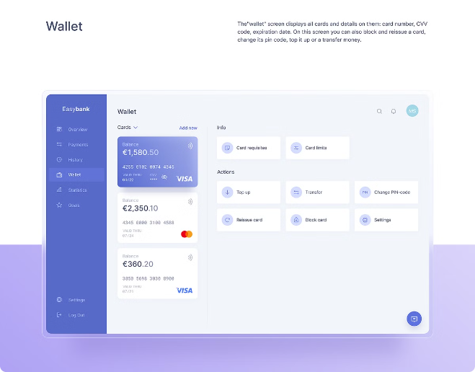
Logging In
1
Secure Authentication
The login process ensures secure authentication, enabling users to access their accounts with confidence. Robust security measures, such as password encryption and multi-factor authentication, protect sensitive information from unauthorized access.
2
Personalized Dashboard
Upon successful login, users are presented with a personalized dashboard, providing them with a comprehensive overview of their banking activities, including account balances, recent transactions, and customizable settings.
3
Seamless Navigation
The intuitive user interface allows for seamless navigation, enabling users to quickly and efficiently access the various features of the Bank Management System, streamlining their banking experience.

Slide 3
Balance Inquiry
Real-Time Updates
Transaction History
Customizable Alerts
The Balance Inquiry feature provides users with real-time updates on their account balances, ensuring they have a accurate and up-to-date understanding of their financial standing.
Users can easily view their complete transaction history, allowing them to track their spending patterns, identify recurring payments, and monitor their overall financial activities.
The system offers customizable alerts, notifying users of account balances, low fund thresholds, and other important financial events, empowering them to stay on top of their finances.

Slide 4

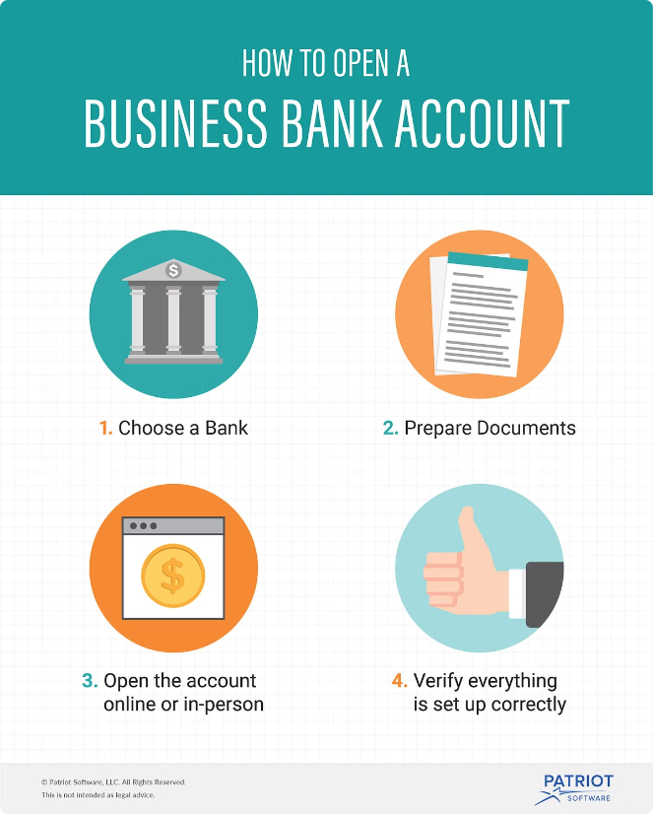
Account Creation
1
Personal Information
The account creation process begins by capturing the user's personal information, such as name, contact details, and identification documents, ensuring a secure and compliant onboarding experience.
2
Account Selection
Users can choose from a variety of account types, tailored to their specific financial needs, whether it's a savings account, checking account, or a specialized product like a retirement or investment account.
3
Funding the Account
Once the account is set up, users can easily fund their new account through various payment methods, including direct deposit, wire transfer, or check, allowing them to start their banking journey with confidence.

Slide 5

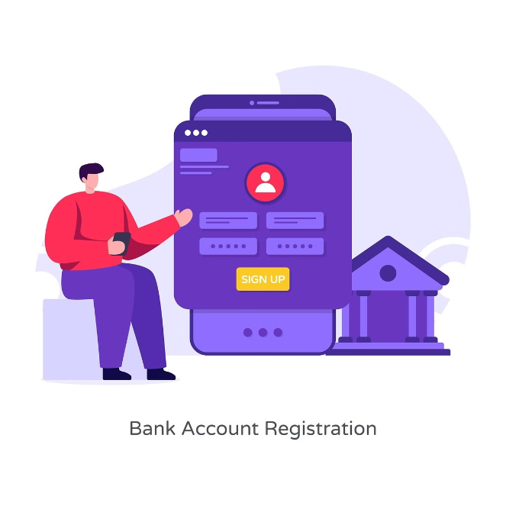
Registration and Account Management
Secure Registration
The registration process ensures the security of user information by implementing robust authentication measures, including password hashing, two-factor authentication, and secure data storage protocols.
Account Management
Users can manage their account details, update personal information, and modify account settings, all within a user-friendly interface, empowering them to take control of their banking experience.
Password Reset
In the event of a forgotten password, the system provides a secure password reset functionality, allowing users to regain access to their accounts without compromising the overall security of the system.
Fraud Detection
The Bank Management System employs advanced fraud detection algorithms to monitor user activities, identify suspicious transactions, and alert users to potential security breaches, safeguarding their financial well-being.

Slide 6




Withdrawal and Deposit
Withdrawal
Users can easily initiate withdrawal transactions, specifying the desired amount and the source account. The system verifies the available balance, processes the withdrawal, and updates the user's account accordingly.
Deposit
Depositing funds into an account is a straightforward process, allowing users to add money to their accounts through various methods, including cash, check, or electronic transfer. The system promptly updates the account balance upon successful deposit.
Transaction History
All withdrawal and deposit transactions are recorded in the user's transaction history, providing a comprehensive record of their financial activities and enabling them to monitor their account balance and spending patterns.

Slide 7
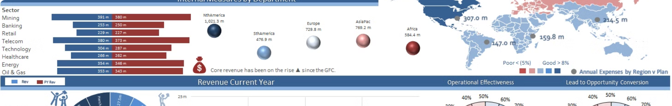




Reports and Analytics
Financial Insights
Customizable Statements
Performance Tracking
Data Export
The Bank Management System offers robust reporting and analytics capabilities, providing users with comprehensive financial insights, including spending trends, account balances, and transaction summaries.
Users can easily export their account information and transaction data in various formats, such as CSV or PDF, for further analysis or integration with third-party financial management tools.
Users can generate personalized account statements, tailoring the format and frequency to their preferences, enabling them to stay informed and make informed financial decisions.
The system tracks the performance of the bank's overall operations, allowing managers and executives to monitor key metrics, identify areas of improvement, and make data-driven strategic decisions.

Slide 8


Conclusion
The Bank Management System is a comprehensive and innovative solution that streamlines the core operations of a financial institution. By offering a seamless and secure user experience, the system empowers customers to manage their finances with confidence, while providing banks with the tools and insights necessary to optimize their operations and maintain a competitive edge in the ever-evolving banking landscape. This project is a testament to the power of Java-based software development in transforming the banking industry and enhancing the overall financial well-being of individuals and businesses alike.

Slide 9

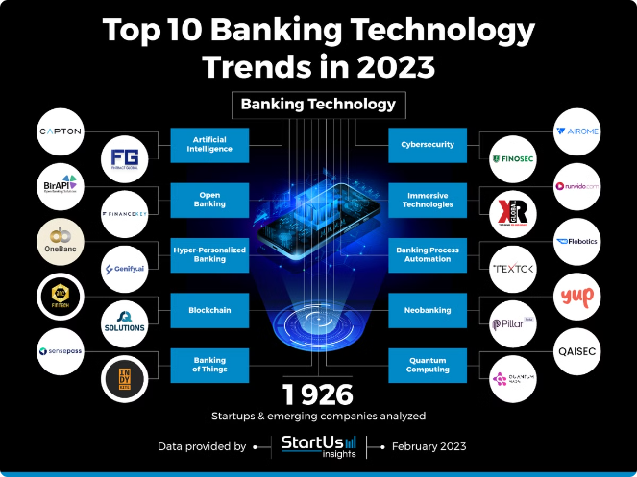
Future Scope
1
Mobile Integration
Expanding the Bank Management System to include a robust mobile application will provide users with increased accessibility and convenience, allowing them to manage their finances on-the-go.
2
Artificial Intelligence
Integrating advanced AI-powered technologies, such as machine learning and natural language processing, can enhance the system's capabilities, enabling intelligent financial recommendations, personalized customer service, and predictive analytics.
3
Blockchain Integration
Incorporating blockchain technology can further strengthen the system's security, transparency, and efficiency, revolutionizing the way financial transactions are processed and recorded.
4
Regulatory Compliance
Continuous updates to the system to ensure compliance with evolving banking regulations and industry standards will maintain the Bank Management System's relevance and trustworthiness in the eyes of customers and regulatory bodies.

Slide 10


Areas of Improvement
User Experience
Enhance the user interface and navigation to provide an even more intuitive and seamless experience for customers.
Security
Implement additional security measures, such as biometric authentication and advanced fraud detection algorithms, to further protect user data and prevent unauthorized access.
Scalability
Ensure the system can handle increasing user volumes and transaction loads without compromising performance, allowing the bank to grow and serve a larger customer base.
Integrations
Develop robust integration capabilities with third-party financial services and accounting tools, enabling seamless data exchange and enhanced functionality for users.

